Slide 1

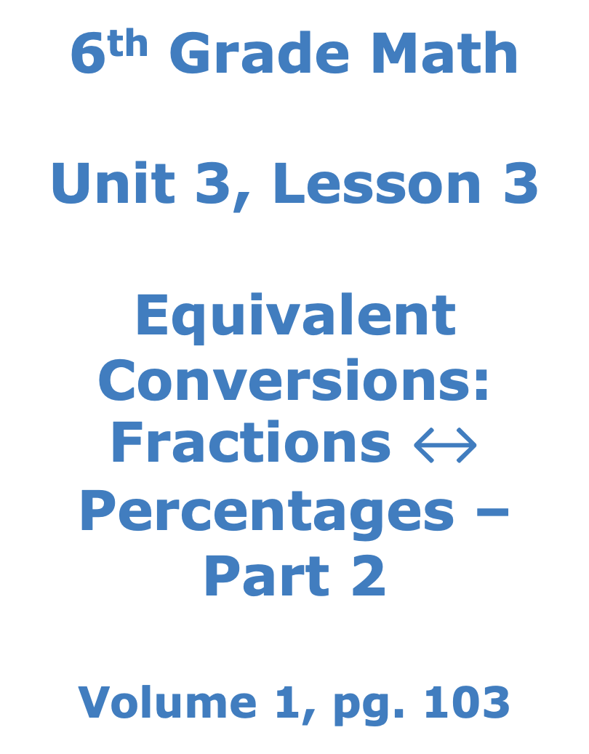
6th Grade Math Unit 3, Lesson 3 Equivalent Conversions: Fractions $↔$ Percentages – Part 2 Volume 1, pg. 103

Slide 2


Benchmark
MA.6.NSO.3.5
Rewrite positive rational numbers in different but equivalent forms including fractions, terminating decimals, and percentages.
volume 1, pg. 103

Slide 3
Integrated Mathematical Thinking and Reasoning Standards
MA.K12.MTR.3.1 Complete tasks with mathematical fluency.
MA.K12.MTR.4.1 Engage in discussions that reflect on the mathematical thinking of self and others.
volume 1, pg. 103

Slide 4

Learning Targets
I can convert between fractions and percentages.
I can rewrite positive rational numbers in different but equivalent forms.
volume 1, pg. 103

Slide 5

Warm-Up
volume 1, pg. 104

Slide 6
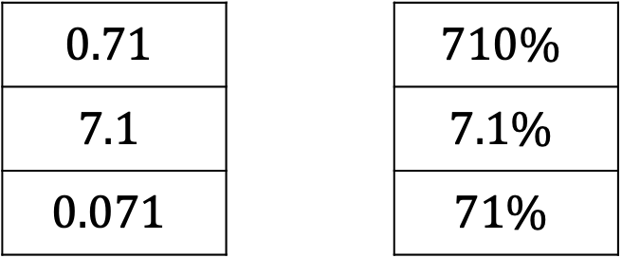
3.3.1 Warm-Up: Matching Puzzle
Several values, expressed as decimals and percentages, are given.
Match the values in the left column with their equivalent form in the right column by drawing lines to connect them.
Describe how you determined which values are equivalent.
$$0.71$$ |  | $$710\%$$
$$7.1$$ |  | $$7.1\%$$
$$0.071$$ |  | $$71\%$$
volume 1, pg. 104

Slide 7

Guided Instruction
volume 1, pg. 104

Slide 8
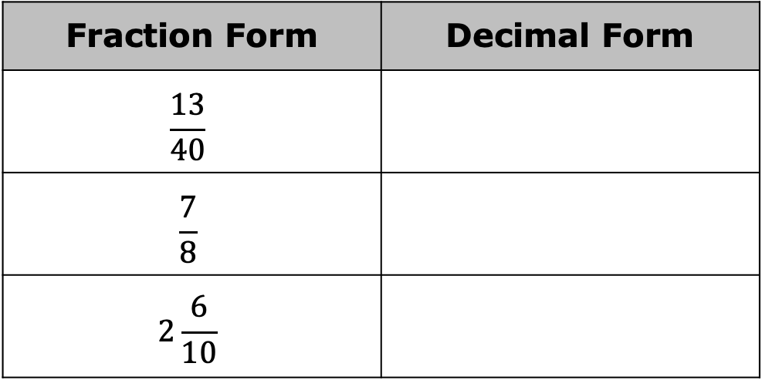
3.3.2 Guided Instruction: Rewriting Rational Numbers in Equivalent Forms
Recall from Lesson 1 that a fraction can be converted into its equivalent decimal form by dividing the numerator by the denominator.
Complete the table by rewriting the fraction into an equivalent decimal form.
Fraction Form | Decimal Form
$$\frac{13}{40}$$
$$\frac{7}{8}$$
$$2\frac{6}{10}$$
volume 1, pg. 105

Slide 9
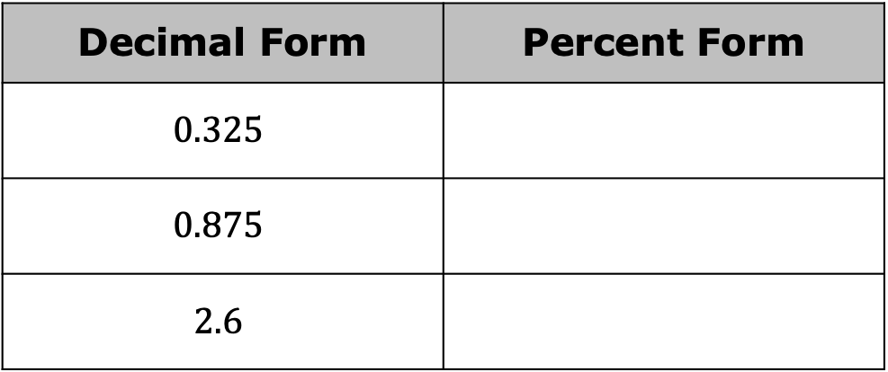

Complete the table by rewriting the decimal into an equivalent percentage.
What is the equivalent decimal form of $\frac{5}{8}$?
What is $0.625$ rewritten as a percentage?
What is $\frac{5}{8}$ rewritten as a percentage?
Decimal Form | Percent Form
$$0.325$$
$$0.875$$
$$2.6$$
volume 1, pg. 105

Slide 10
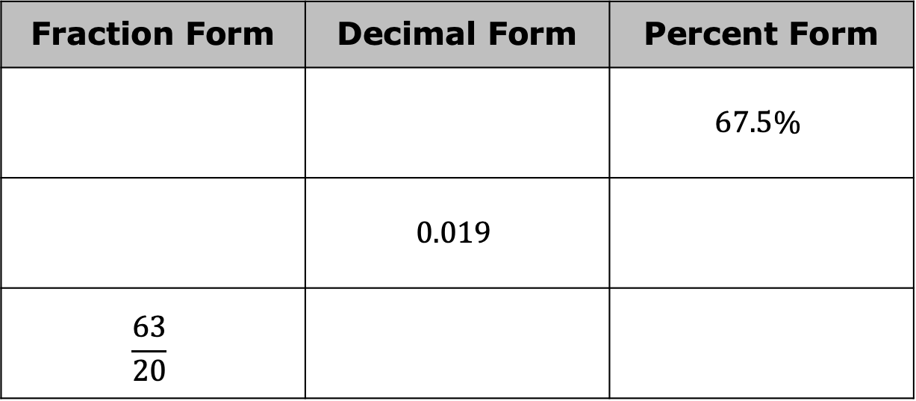
When rewriting a fraction as a percentage, why might it be helpful to first rewrite it in its equivalent decimal form?
Complete the table by rewriting each value in its equivalent forms.
Fraction Form | Decimal Form | Percent Form
 |  | $$67.5\%$$
 | $$0.019$$
$$\frac{63}{20}$$
volume 1, pg. 105

Slide 11

Collaboration
volume 1, pg. 106

Slide 12

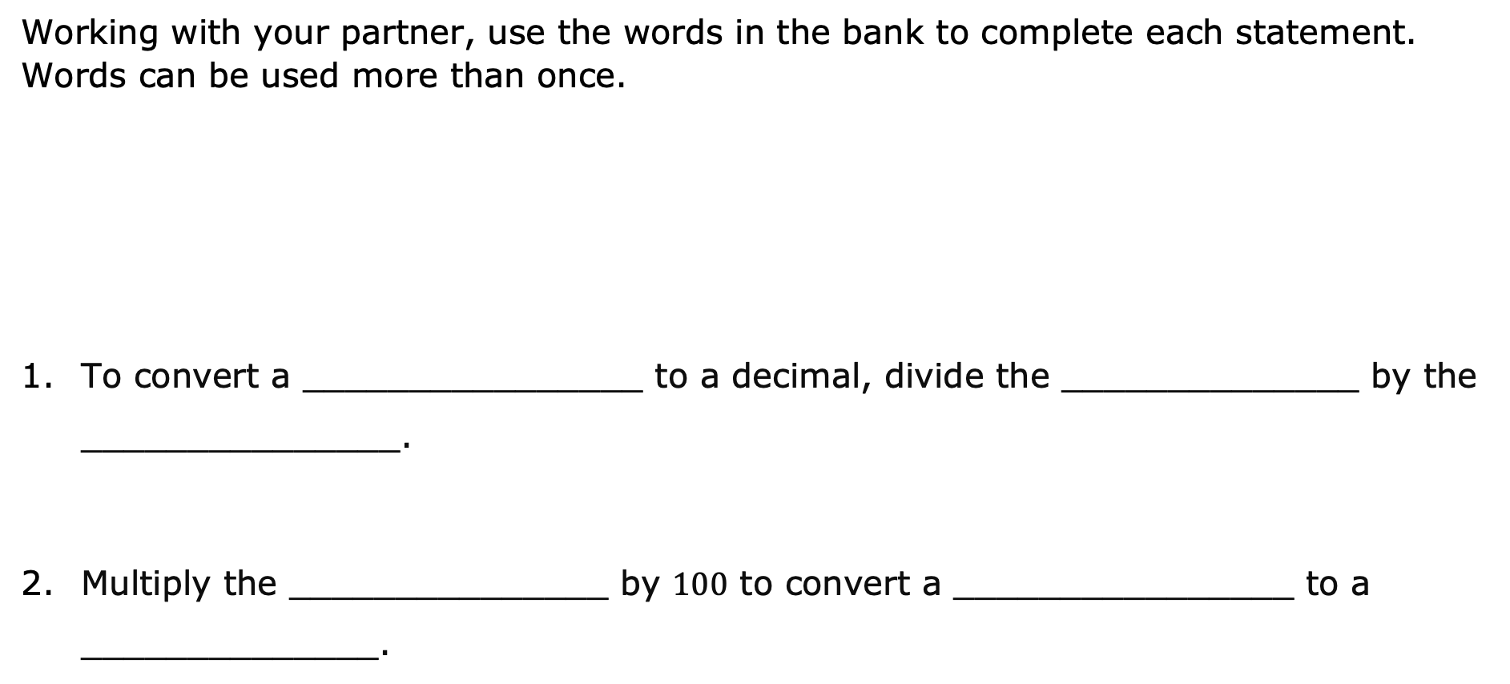
3.3.3 Collaboration: Strategies for Rewriting Rational Numbers
Working with your partner, use the words in the bank to complete each statement. Words can be used more than once.
To convert a ________________ to a decimal, divide the ______________ by the _______________.
Multiply the _______________ by $100$ to convert a ________________ to a ______________.
Word Bank
decimal | denominator | fraction
numerator | percentage | place value
volume 1, pg. 106

Slide 13
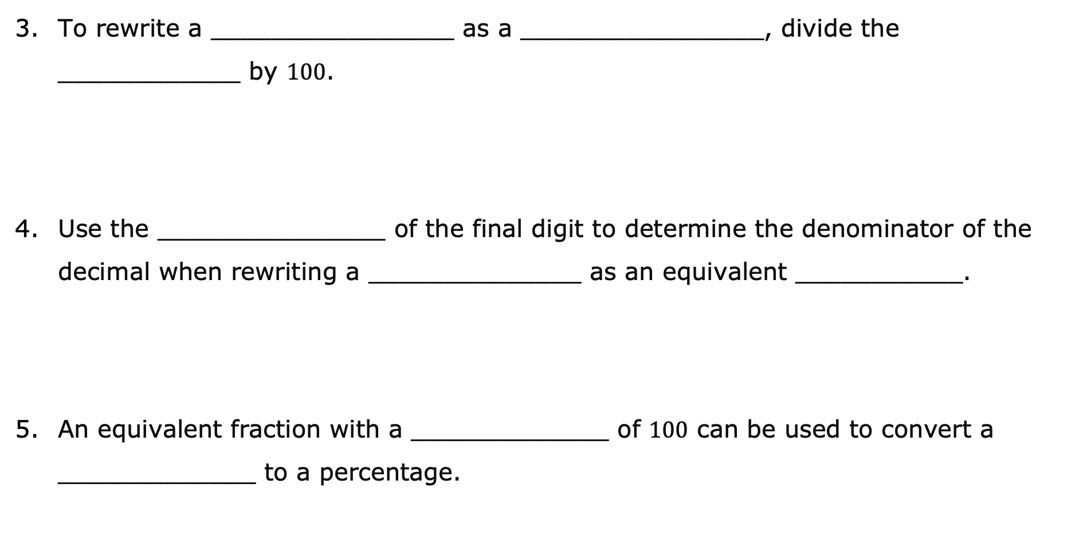
To rewrite a ________________ as a ________________, divide the ____________ by $100$.
Use the _______________ of the final digit to determine the denominator of the decimal when rewriting a ______________ as an equivalent ___________.
An equivalent fraction with a _____________ of $100$ can be used to convert a _____________ to a percentage.
volume 1, pg. 106

Slide 14

Guided Practice
volume 1, pg. 106

Slide 15

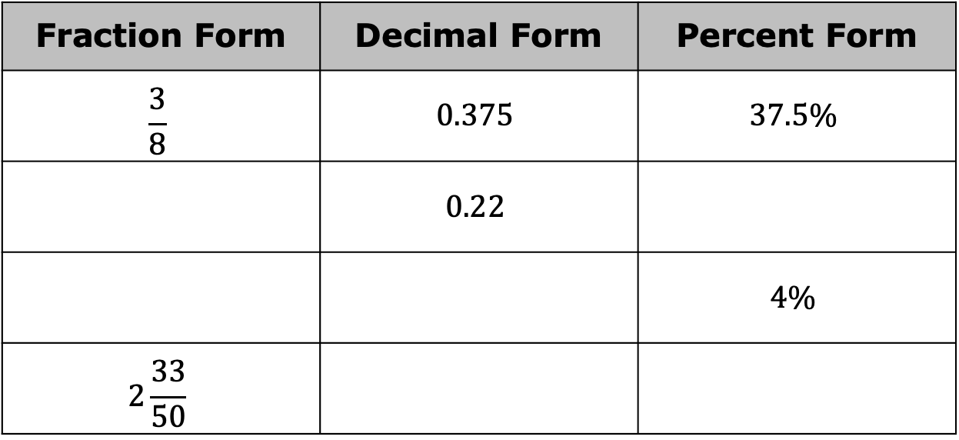
3.3.4 Guided Practice: Rewriting Rational Numbers in Equivalent Forms
Complete the table by rewriting each value in its equivalent forms.
Fraction Form | Decimal Form | Percent Form
$$\frac{3}{8}$$ | $$0.375$$ | $$37.5\%$$
 | $$0.22$$
 |  | $$4\%$$
$$2\frac{33}{50}$$
volume 1, pg. 106

Slide 16

Wrap-Up
volume 1, pg. 107

Slide 17
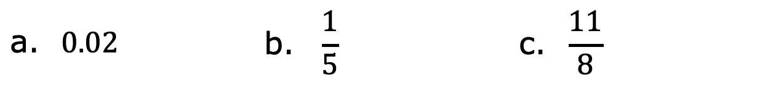
3.3.5 Wrap-Up: Ticket Out the Door
Rewrite each value as an equivalent percentage.
Rewrite each value as an equivalent fraction.
a. $0.02$ | $$\text{b}\text{. }\frac{1}{5}$$ | $$\text{c}\text{. } \frac{11}{8}$$
a. $67\%$ | b. $0.375$ | c.$35.65$
volume 1, pg. 107

